Slide 1



The Effects of Nearby Surveillance on High School Graduation Rates
Noah Carey

Slide 2
Research Question
Are high school graduation rates affected by the prevalence of nearby security cameras?

Slide 3
Methodology
Two Main Data Sets
Data Sources:
Baltimore City School Zones
Baltimore County High School Districts
D.C. High School Attendance Zones
Baltimore City School Zones Graduation Rates
Baltimore County High School Graduation Rate
D.C. High School Graduation Rates
Baltimore City School Zones: Open Baltimore
Baltimore County School Districts: Baltimore County Government
D.C. Attendance Zones: Open Data DC
Baltimore City Graduation Rates: Open Baltimore
Baltimore County Graduation Rates: Maryland State Department of Education
D.C. Graduation Rates: D.C. Public Schools
Baltimore City Cameras: Open Baltimore
Baltimore County Cameras: Baltimore County Open Data + Directly from County GIS Team
D.C. Cameras: Surveillance Under Surveillance
Baltimore City School Locations: Open Baltimore
Baltimore County School Locations: Baltimore County Open Data
D.C. School Locations: Open Data DC
&
Balitmore City Cameras
Baltimore County Cameras
D.C. Security Cameras

Slide 4
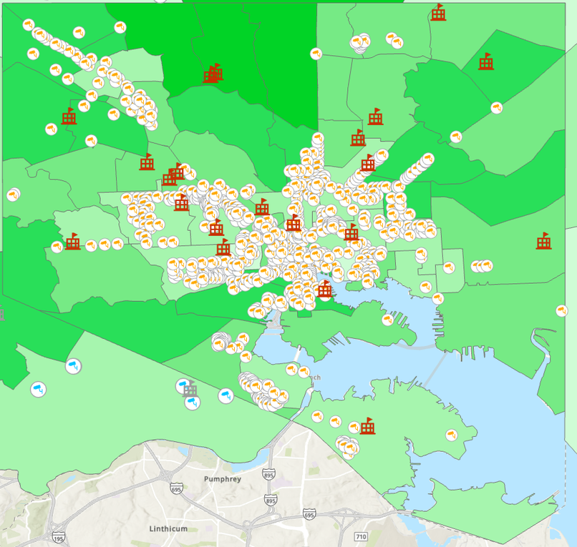
Methodology
Step 1: Import Shapefiles
Step 2: Import Graduation Rates
Step 3: Import Security Cameras
Step 4: Import School Locations
Data Caveats:
All data is for 2023
MacArthur High School was renamed
Duke Ellington High School
Baltimore County’s graduation rates
had to be input manually
D.C.’s Cameras had to be downloaded in three chunks and converted to points from a CSV and then combined
The elementary and middle schools from Baltimore City and D.C. had to be trimmed

Slide 5
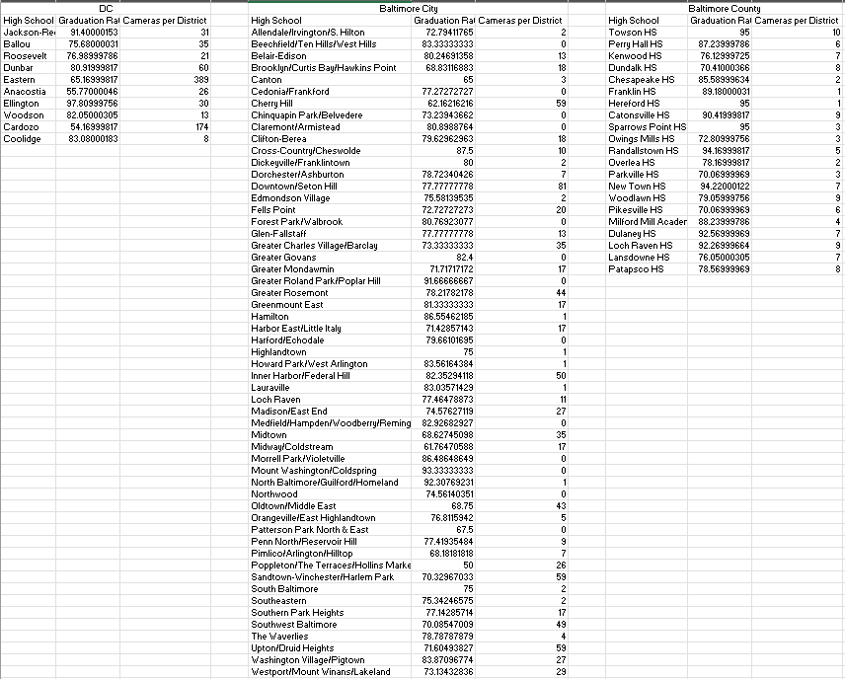

Analysis
Summarize Within: Used to find out how many cameras were located in each zone
New table was exported as an excel
Regression analysis was conducted on the resulting dataset

Slide 6
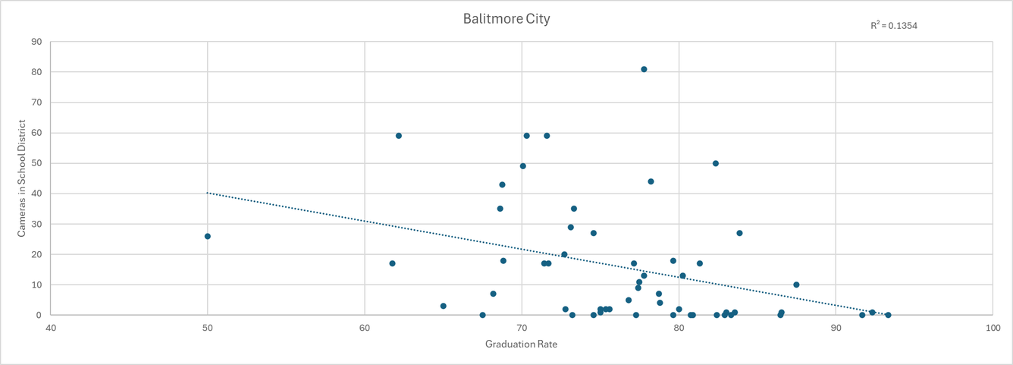
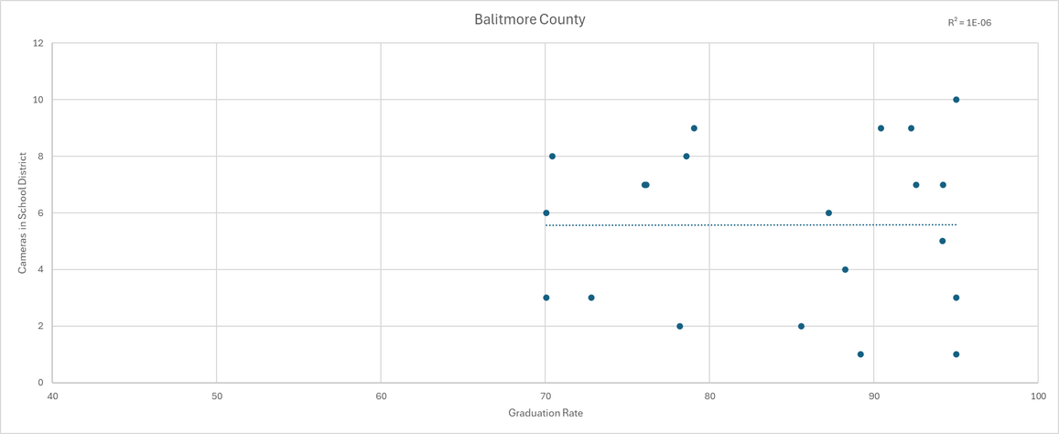
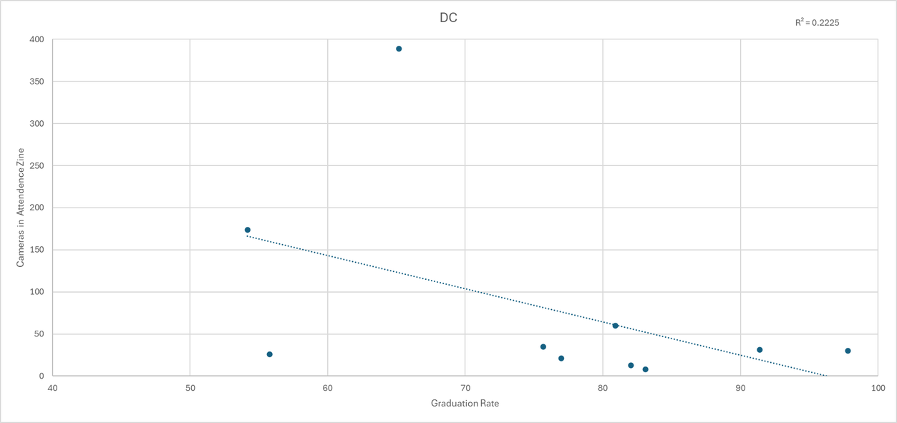
Analysis

Slide 7
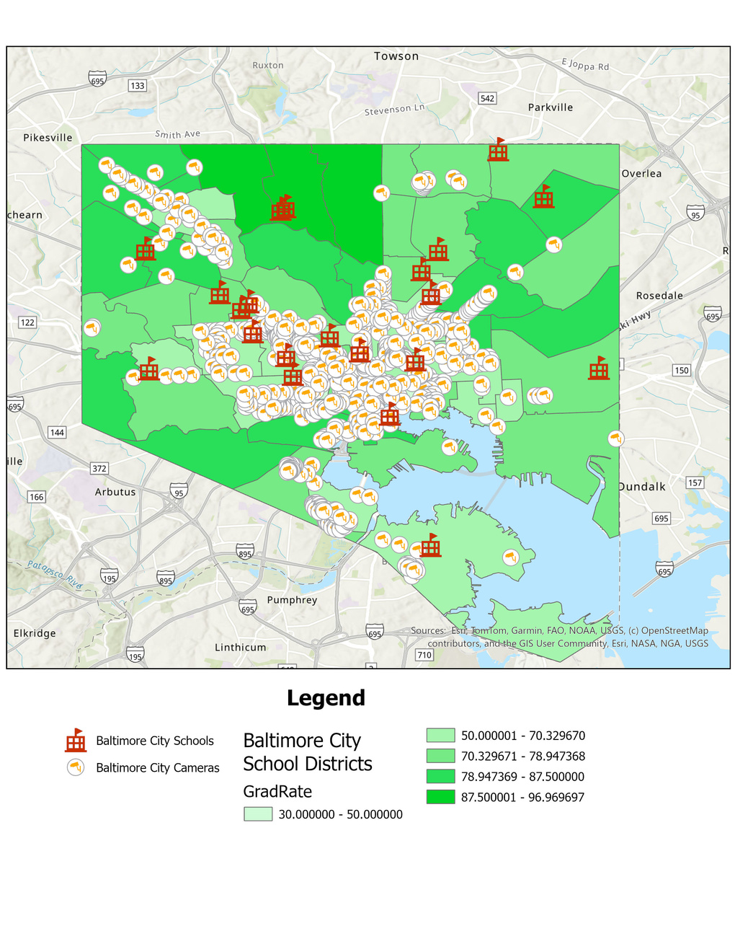
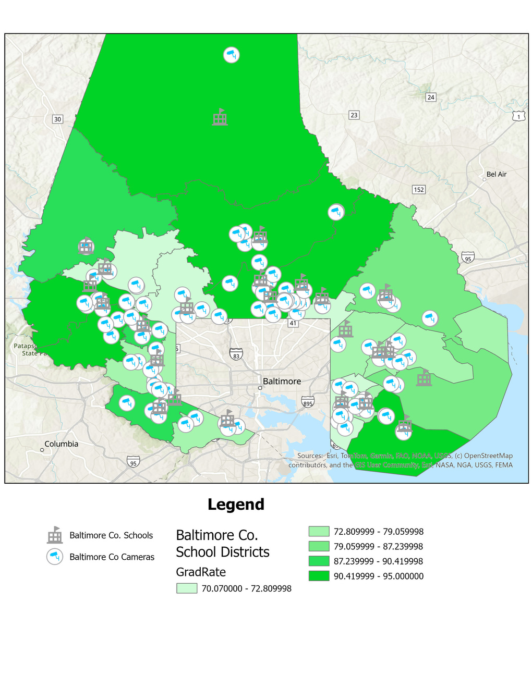
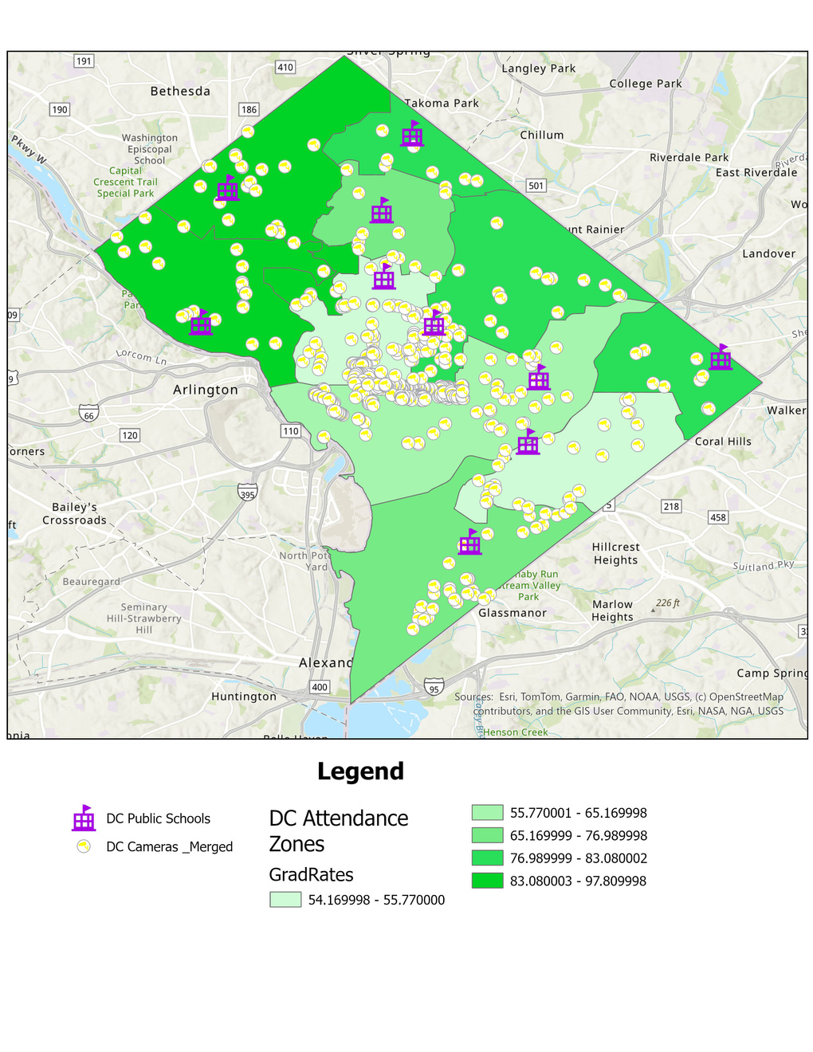
Analysis

Slide 8
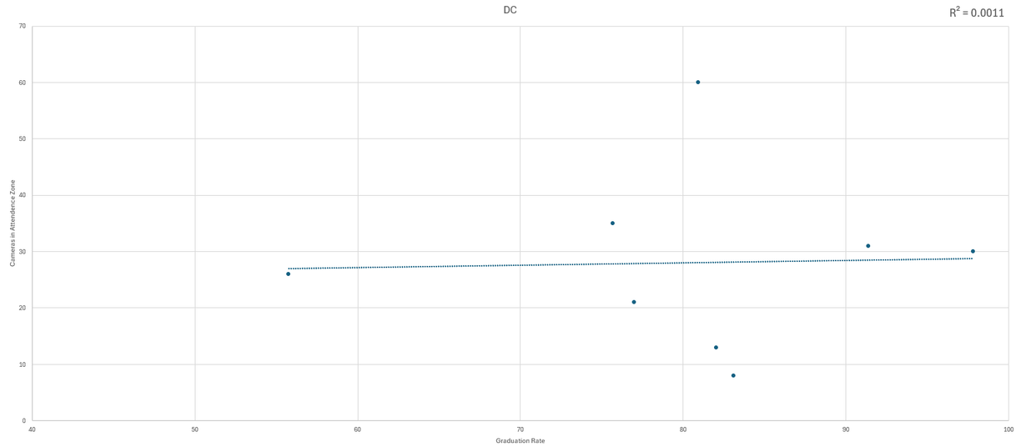
Results
Regression analysis shows no correlation between high school graduation rates and nearby security cameras
Baltimore City: R2 = .135
Baltimore Co. = 1.37E - 06
DC = .222
Removing the outliers actually lowers the correlation for DC
More in line with Baltimore City

Slide 9
Results
Schools are not doing worse due to proximity or density
Results are more in line with demographic features
Camera proximity does not appear to have an impact

Slide 10
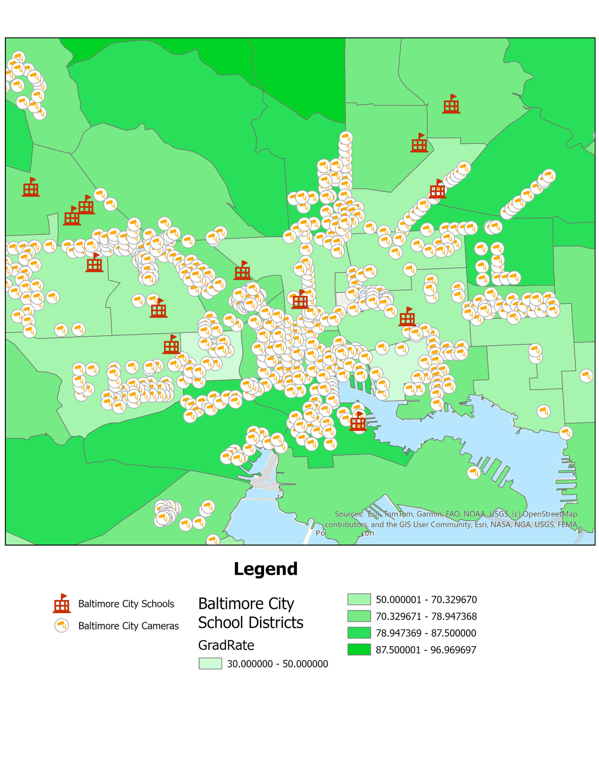

Results
Sheer density of security cameras in Baltimore
Varying proximity, no impact on graduation rates

Slide 11
Conclusion
Two possible outcomes from this investigation:
There does not exist enough of a ‘surveillance culture’ outside of schools to affect high school graduation rates
The prevalence of security cameras outside of schools does not affect high school graduation rates in the same way security cameras do within schools

Slide 12


QUESTIONS?

Slide 13
References:
Baltimore City (2025) Baltimore City Schools https://data.baltimorecity.gov/datasets/baltimore::baltimore-city-schools/about
Baltimore City (2026) CitiWatch Camera Locations https://data.baltimorecity.gov/datasets/baltimore::citiwatch-camera-locations/about
Baltimore County Government (2025) High Schools https://opendata.baltimorecountymd.gov/datasets/BC-GIS::high-schools-1/about
Baltimore County Government (2025) High School Districts https://opendata.baltimorecountymd.gov/datasets/BC-GIS::high-school-districts/about
Baltimore County Government (2023) Truck Height Cameras https://opendata.baltimorecountymd.gov/datasets/BC-GIS::truck-height-cameras/about
Baltimore Neighborhood Indicators Alliance (2023) High School Completion Rate - Community Statistical Area https://data.baltimorecity.gov/datasets/bniajfi::high-school-completion-rate-1/about?layer=0
District of Columbia Public Schools (2023) DCPS 2023 Graduation Data Overall Subgroup https://dcps.dc.gov/publication/dcps-data-set-graduation-rates
Maryland State Department of Education (2023) Report Card https://reportcard.msde.maryland.gov/SchoolsList/Index?l=03
Open Data DC (2025) DC Public Schools https://opendata.dc.gov/datasets/DCGIS::dc-public-schools/about
Open Data DC (2023) School Attendance Zones (Senior High) https://opendata.dc.gov/datasets/DCGIS::school-attendance-zones-senior-high/about
Open Street Maps Surveillance Under Surveillance https://mapcomplete.org/surveillance.html

